Slide 1
Portfolio Optimization based on Tech Companies Stocks
Yijie Bai

Slide 2
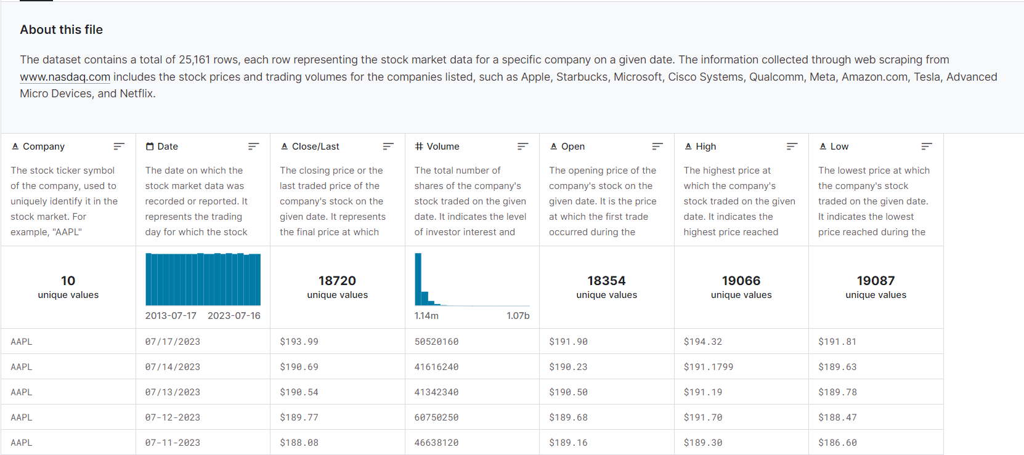
Dataset
https://www.kaggle.com/datasets/khushipitroda/stock-market-historical-data-of-top-10-companies/

Slide 3
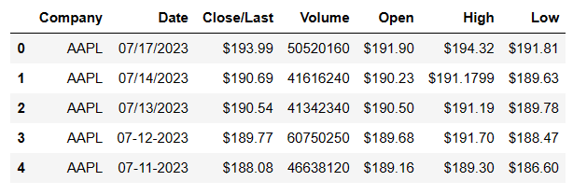
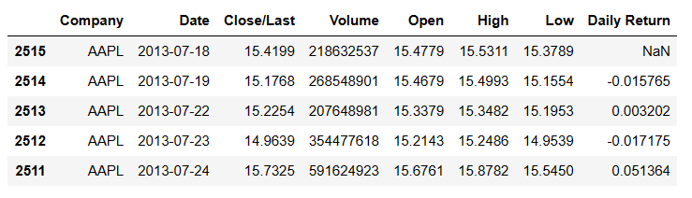
Data Example
Basic Data
Data Frame, sorted

Slide 4
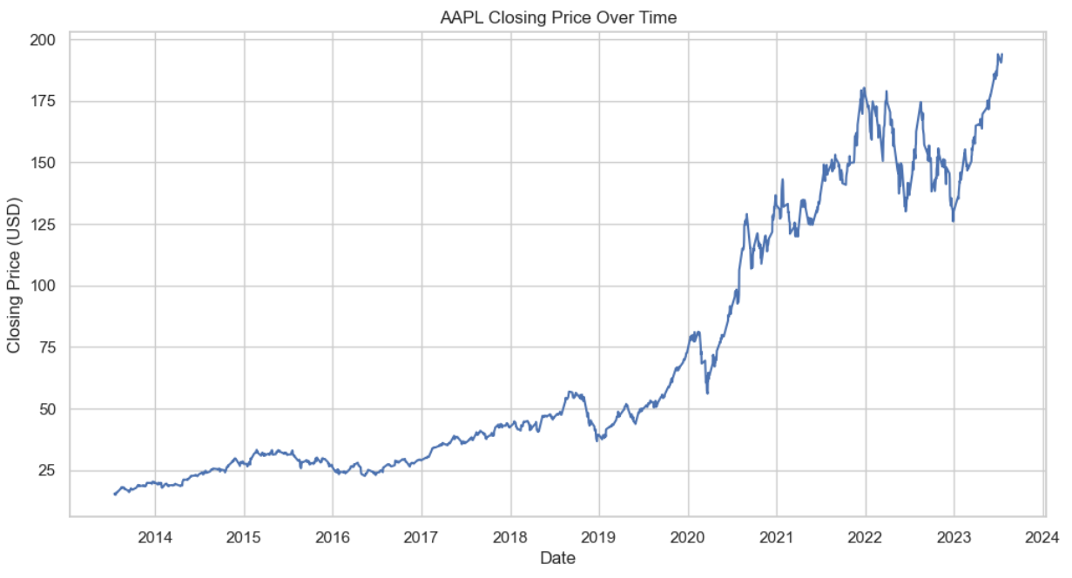
Basic Data Analysis

Slide 5
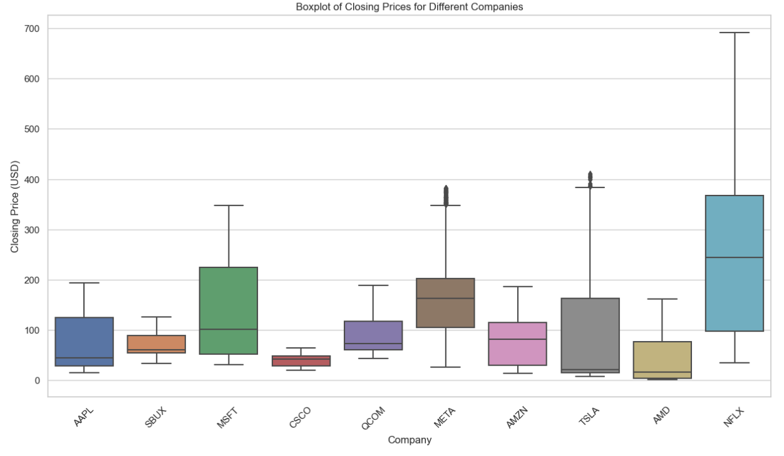
Basic Data Analysis

Slide 6
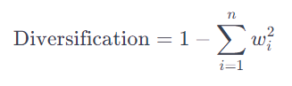
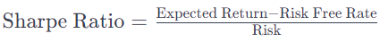
Evaluation of Portfolio Opt Algorithm
Expected Return(per day): The average rate of return expected per day of investment.
Risk (Volatility): Standard Deviation. Indicates the degree of variation in the portfolio's price, with higher volatility implying greater risk.
Sharpe Ratio: The excess return earned per unit of risk. A higher ratio indicates higher investment efficiency.
Diversification: Whether the algorithm effectively diversifies risk by reducing dependence on a single asset.
Don't put all your eggs in one basket

Slide 7
Methods Used
Markowitz Model (Based on Gradient Method)

Slide 8
Markowitz Model (based on Gradient Method)
The Markowitz model is a portfolio optimization model based on mean-variance analysis. Its goal is to maximize returns for a given level of risk or minimize risk for a given level of expected return. In this model, gradient methods are used to find the optimized portfolio. This is an iterative process that adjusts the weights of assets in the portfolio to find the point where the Risk(or other optimization objectives) is maximized. Gradient methods rely on calculating the derivative (or gradient) of the objective function relative to portfolio weights and updating these weights until the optimal solution is found.

Slide 9
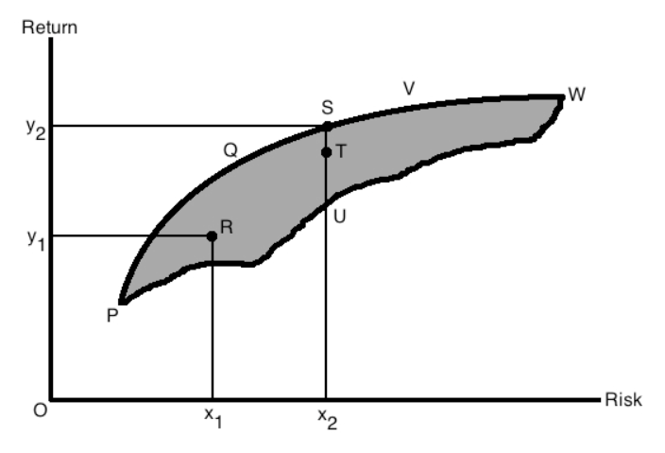

Slide 10
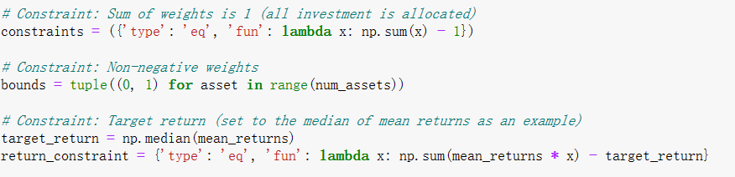
Algorithm Steps
Data Preparation: calculating daily returns for each asset.
Compute Mean Daily Returns and Covariance Matrix: To estimate expected returns and risks.
Define Optimization Problem: Setting up the objective function (maximizing the Excepted Return or minimizing risk), constraints (the sum of weights equal to 1), and boundary conditions (like the range of weights for each asset (>=0) ).

Slide 11
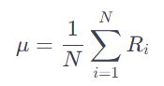
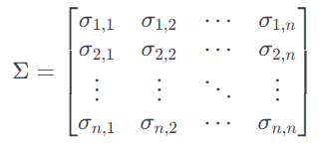
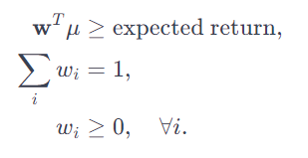
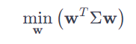
Formula
Mean Daily Return:
Covariance Matrix:
Markowitz Optimization Problem:
subject to
Model performance differ from different expected return. We need to set Expected Return.
Or we can set risk and optimize expected return :)

Slide 12
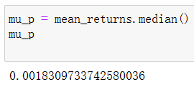
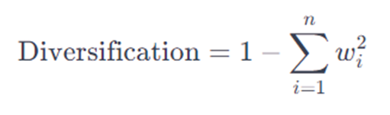
Concepts
We use “Close/Last” to calculate daily returns
Median average return (per day) is 0.00183097337425800 (0.18%)

Slide 13
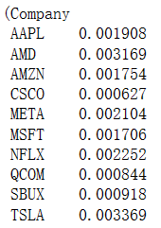
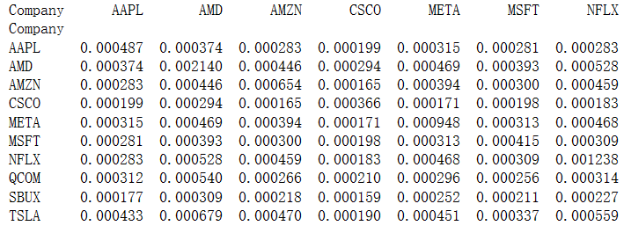
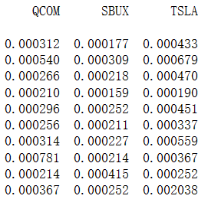
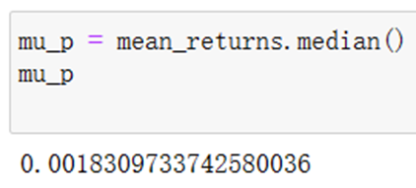
Common Algorithm Output
Daily Return:
Covariance Matrix :
Median average return:

Slide 14
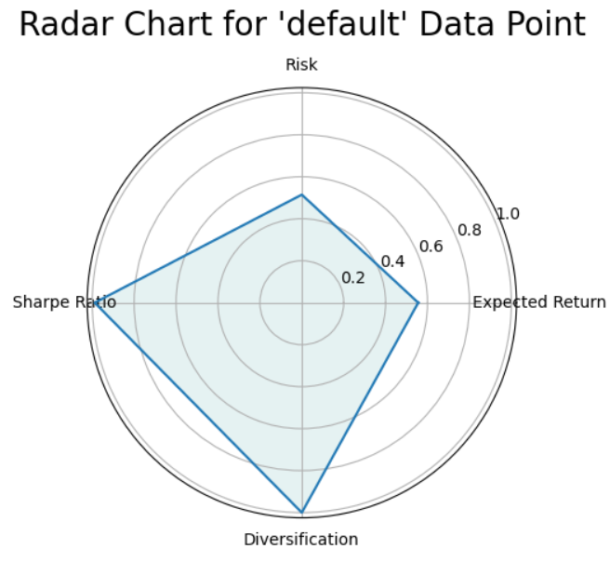
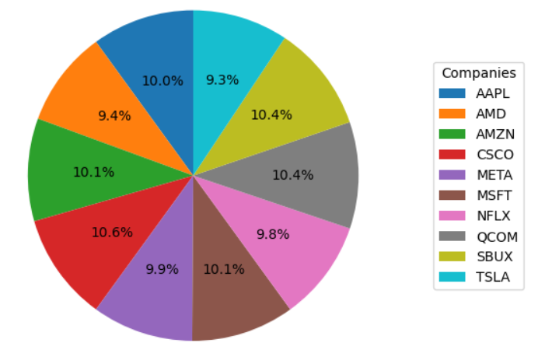
Set median average return 0.18% (default)
I don't think this thing should be considered as an "optimization."

Slide 15
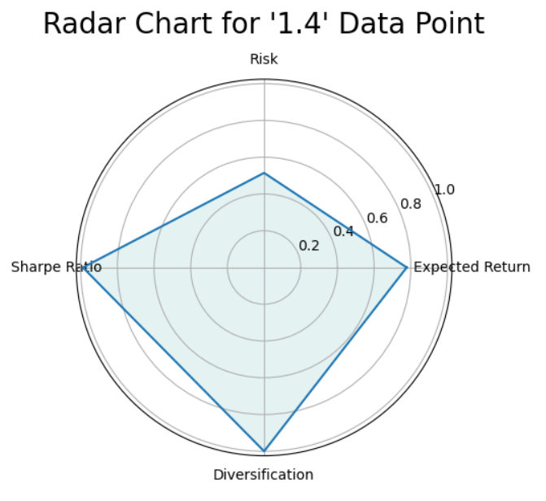
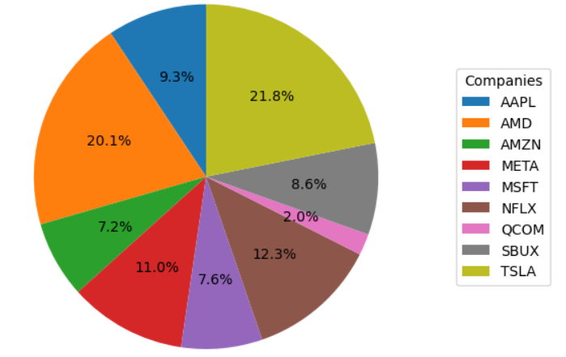
Set median average return 0.25% (1.4*md)

Slide 16
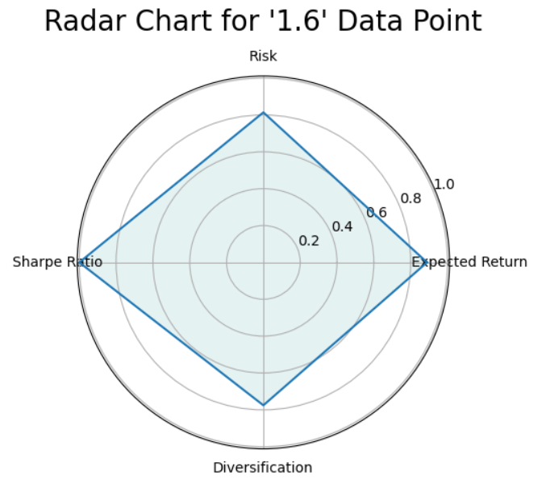
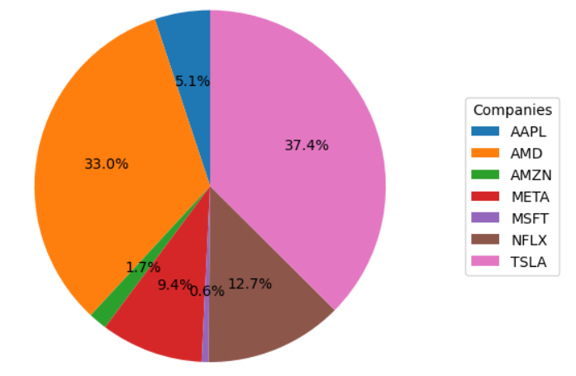
Set median average return 0.29% (1.6*md)

Slide 17
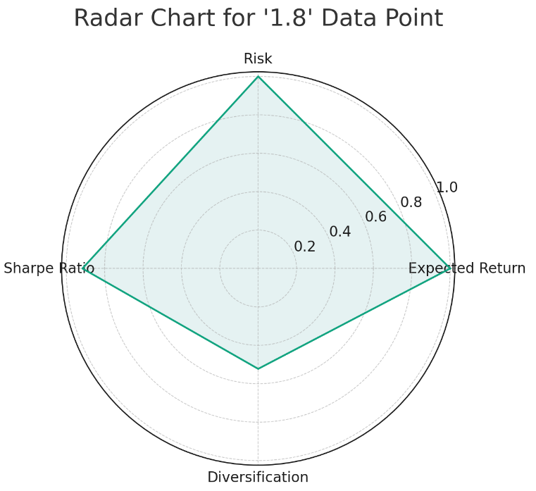
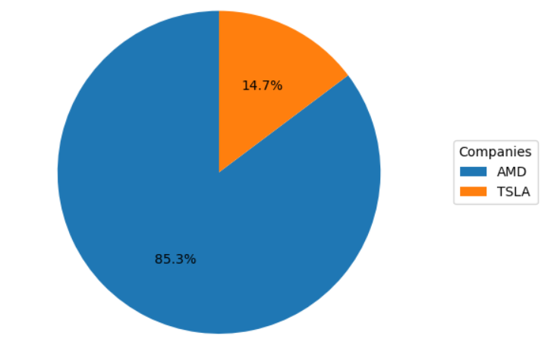
Set median average return 0.324% (1.8*md)

Slide 18
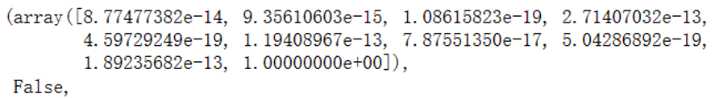
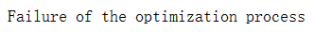
Set expected return 0.36% (approximately 2 times to md.)
No, we CANNOT find a feasible optimal solution in 2*md using Markowitz Model

Slide 19
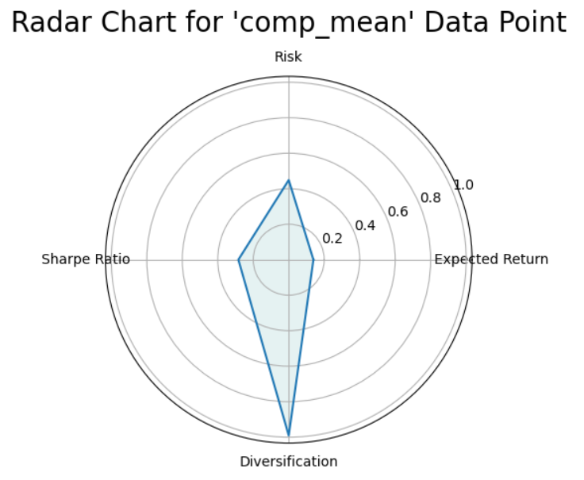
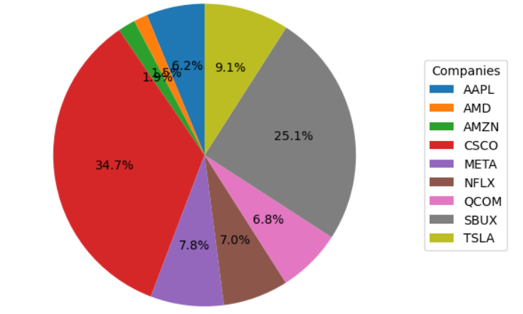
Set mean of 10 companies (average, compare)

Slide 20
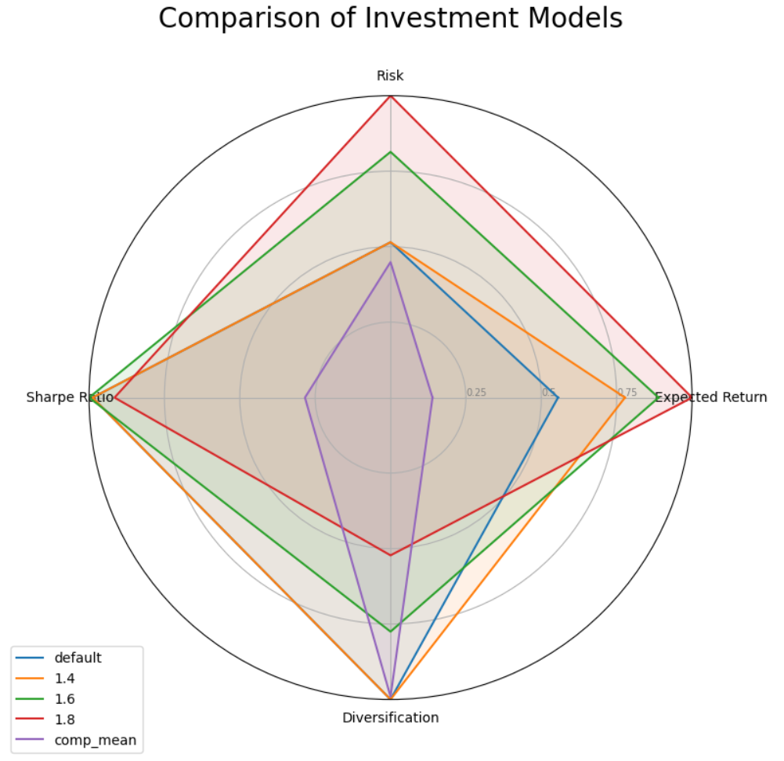
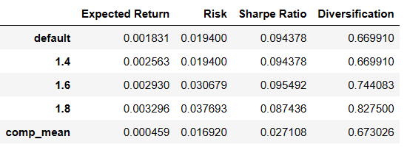
Conclude

Slide 21
Other questions
“I'm interested in high tech concept stocks, I must get my hands on at least 20% of AAPL and 20% of META”
“Due to a business-to-business partnership, I had to purchase 50% AMD stocks for my company. AMD, Yes!”
“I just want to choose between AMD and TSLA to buy, the other stocks don't interest me at all.”

Slide 22
Methods Used
Markowitz Model (Based on Gradient Method)
Markowitz Model (Proximal Gradient Method with restrictive condition)

Slide 23
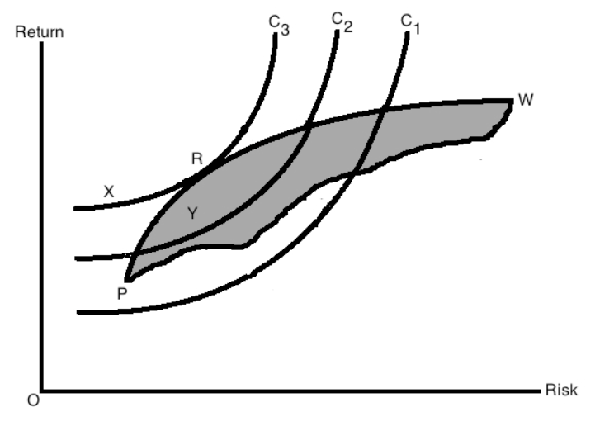

Slide 24
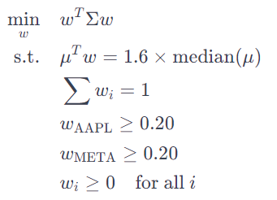
At least 20% of AAPL and 20% of META
I’ll set median average return 0.29% (1.6*md) for the following models, cuz this value excels in all parameters
Markowitz Optimization Problem:

Slide 25
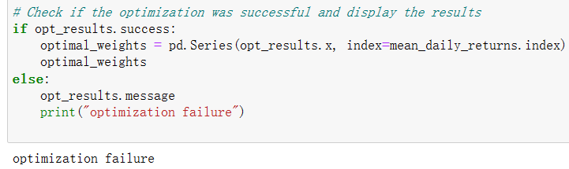
At least 20% of AAPL and 20% of META
No, we CANNOT find a feasible optimal solution in 1.6*md with at least 20% AAPL and 20% META using Markowitz Model
We should change the restrict little bit.

Slide 26
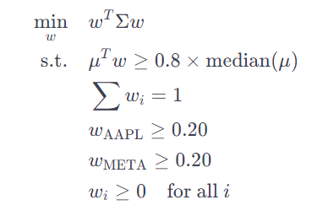
At least 20% of AAPL and 20% of META
Set 0.8*md, maybe it will work?
Markowitz Optimization Problem:

Slide 27
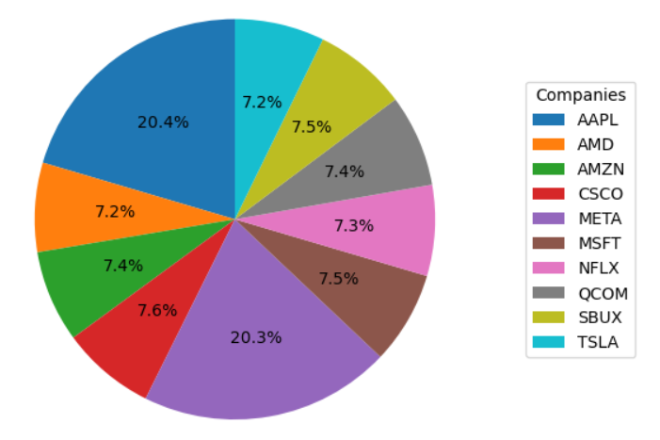
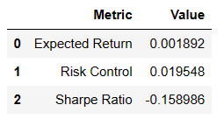
At least 20% of AAPL and 20% of META
It works!
But Sharpe Ratio < 0,
means we may loss money
from this. It is the cost of
making restrict :(
There ain't no such thing as a free lunch

Slide 28
If the time is still enough

Slide 29
More questions
“I don't want to take too many risks! Please give me the optimal strategy for spreading the risk evenly across different assets”

Slide 30
Methods Used
Markowitz Model (Based on Gradient Method)
Markowitz Model (Proximal Gradient Method with restrictive condition)
Risk Parity Analysis (Frank-Wolfe)

Slide 31
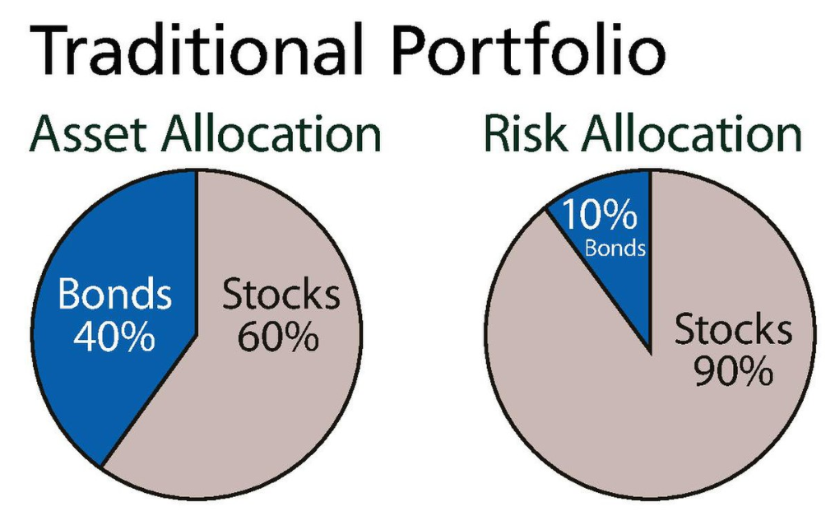

Slide 32
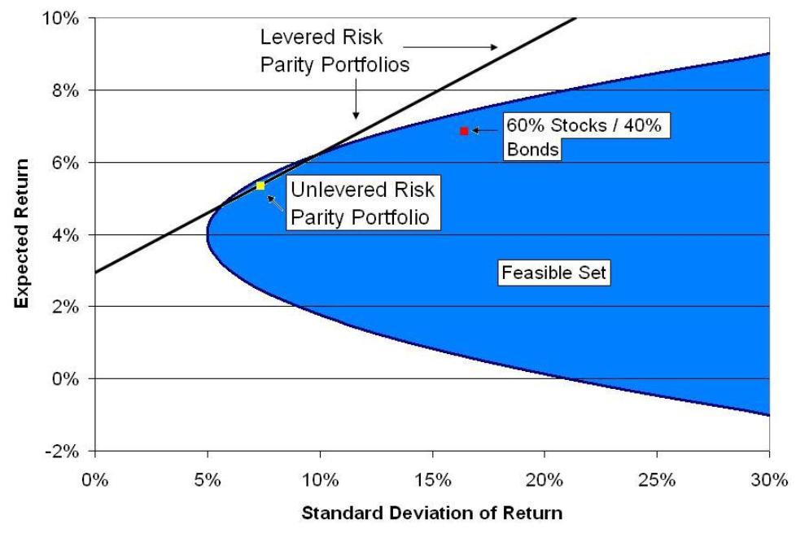

Slide 33
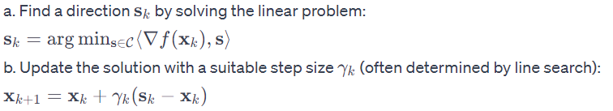
Risk Parity Analysis (Frank-Wolfe)
The main goal of risk parity is not necessarily to maximize returns but to achieve a balance where each asset contributes equally to the portfolio's overall risk. This approach can lead to a more stable investment experience, especially during turbulent market periods.
Optimization problem:

Slide 34
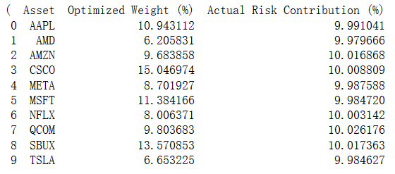
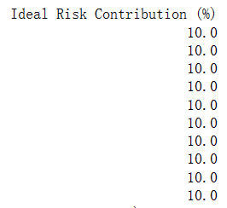
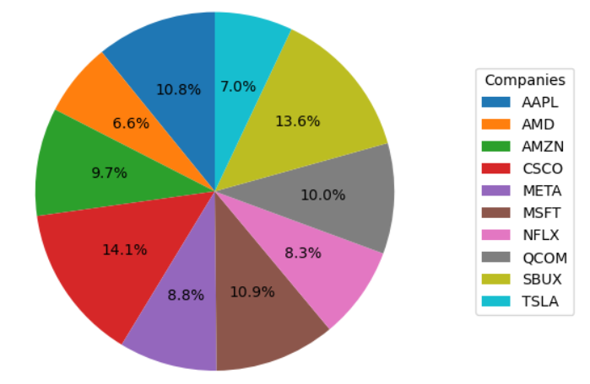

Slide 35
Risk Contribution Balance: The optimization results demonstrate good risk contribution balance, which is the main objective of a risk parity strategy.
Overall Risk Level: The total risk level (volatility) is within a reasonable range but should be contrasted against the investor's risk tolerance and return objectives.
Backtesting Performance and Robustness Tests: This would require additional historical data for analysis. If interested, we can conduct a more in-depth backtesting analysis.
Algorithm Efficiency: The Frank-Wolfe algorithm has shown good efficiency and convergence in dealing with this type of optimization problem.

Slide 36
Some Data Science stuff

Slide 37
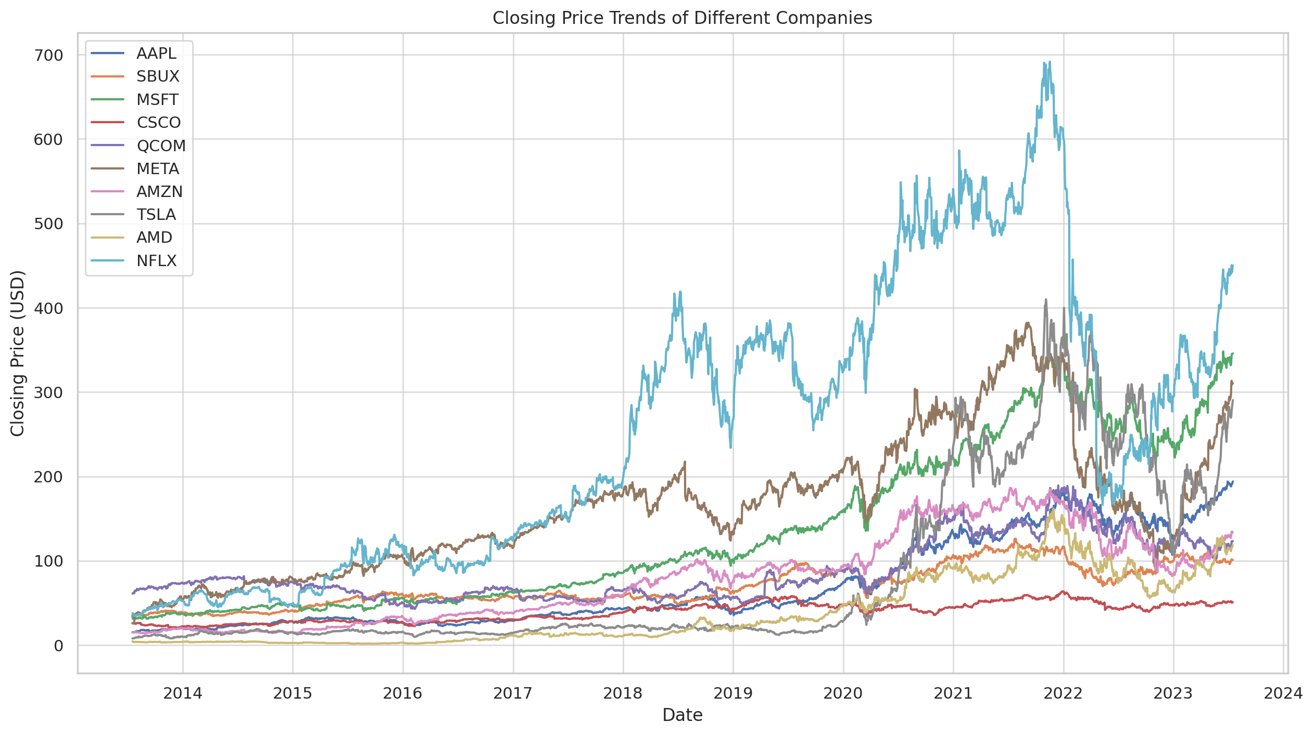

Slide 38
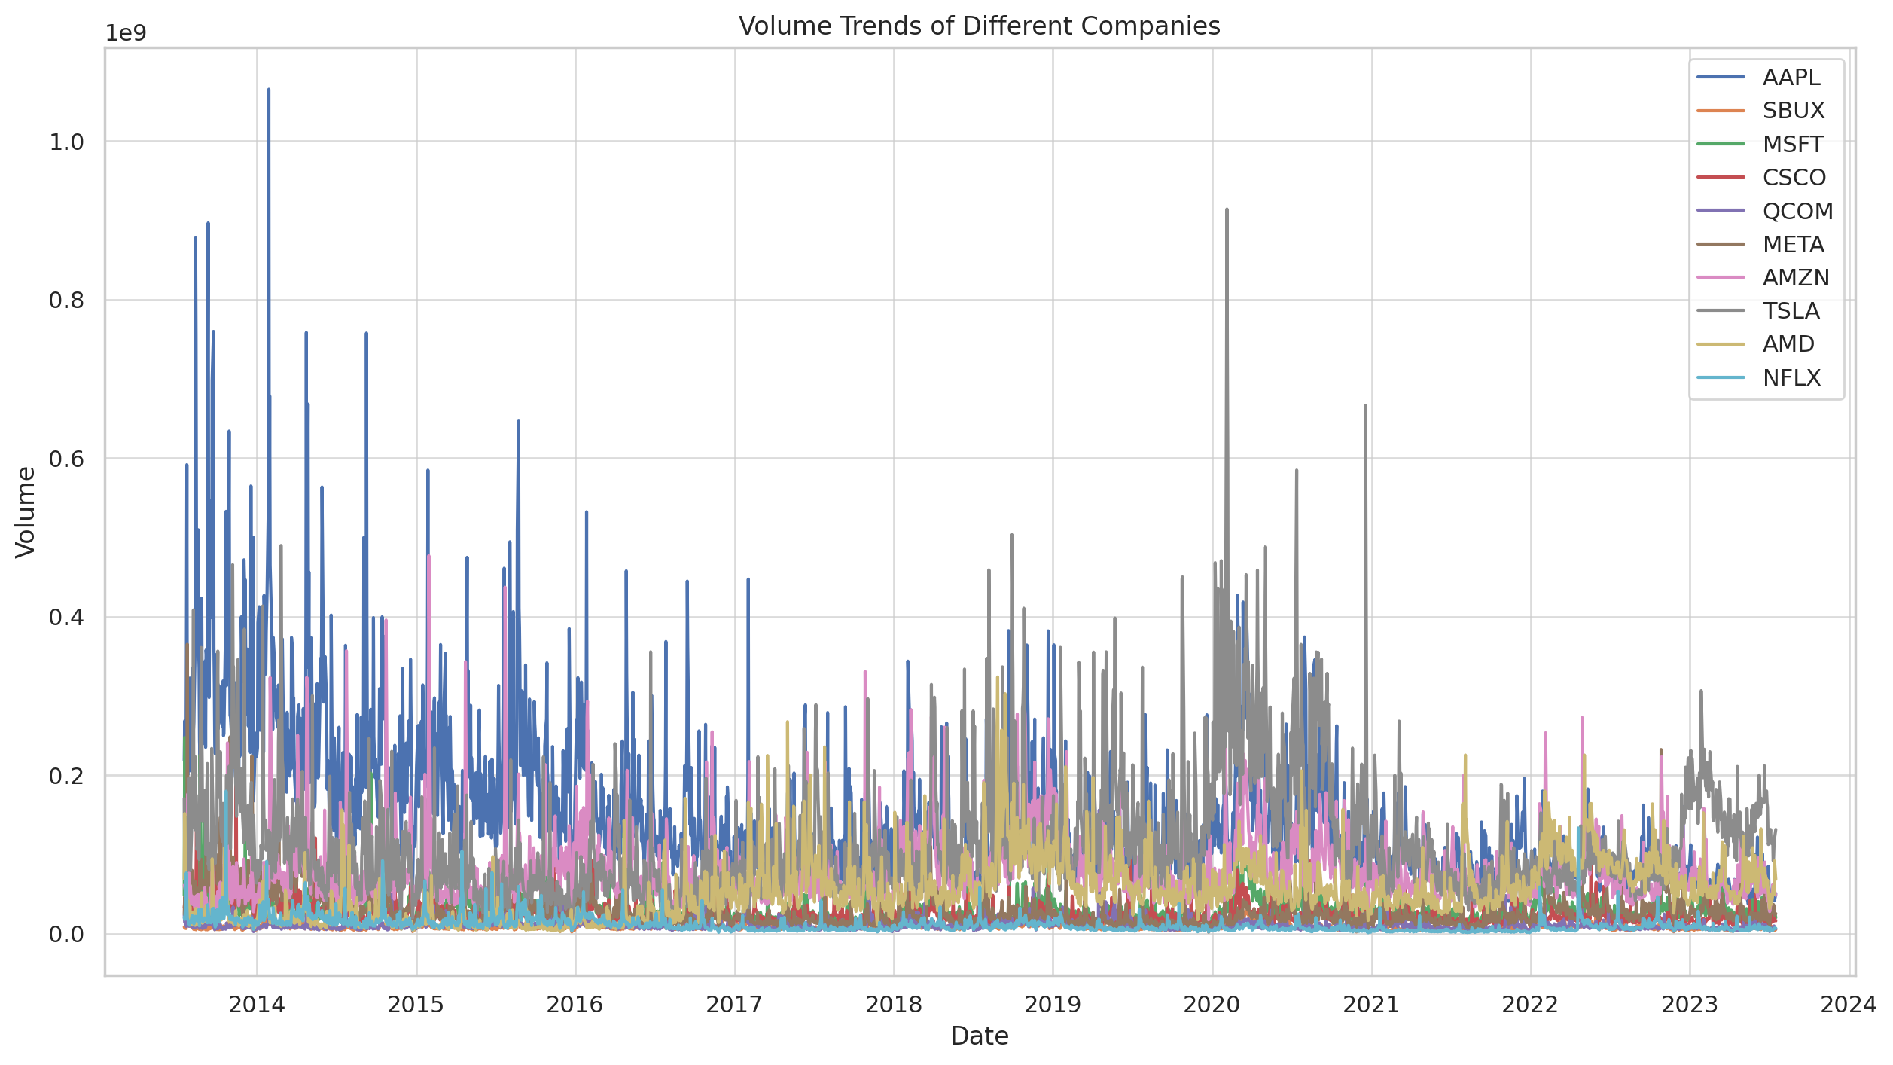

Slide 39
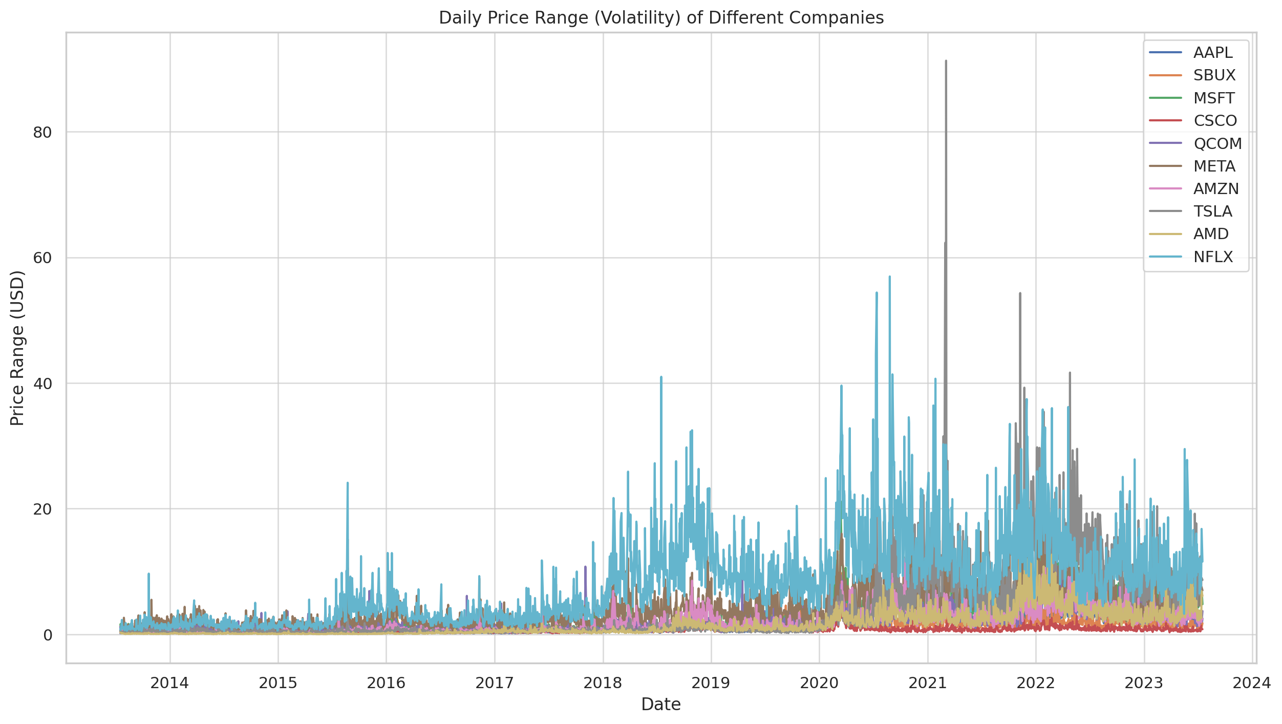

Slide 40
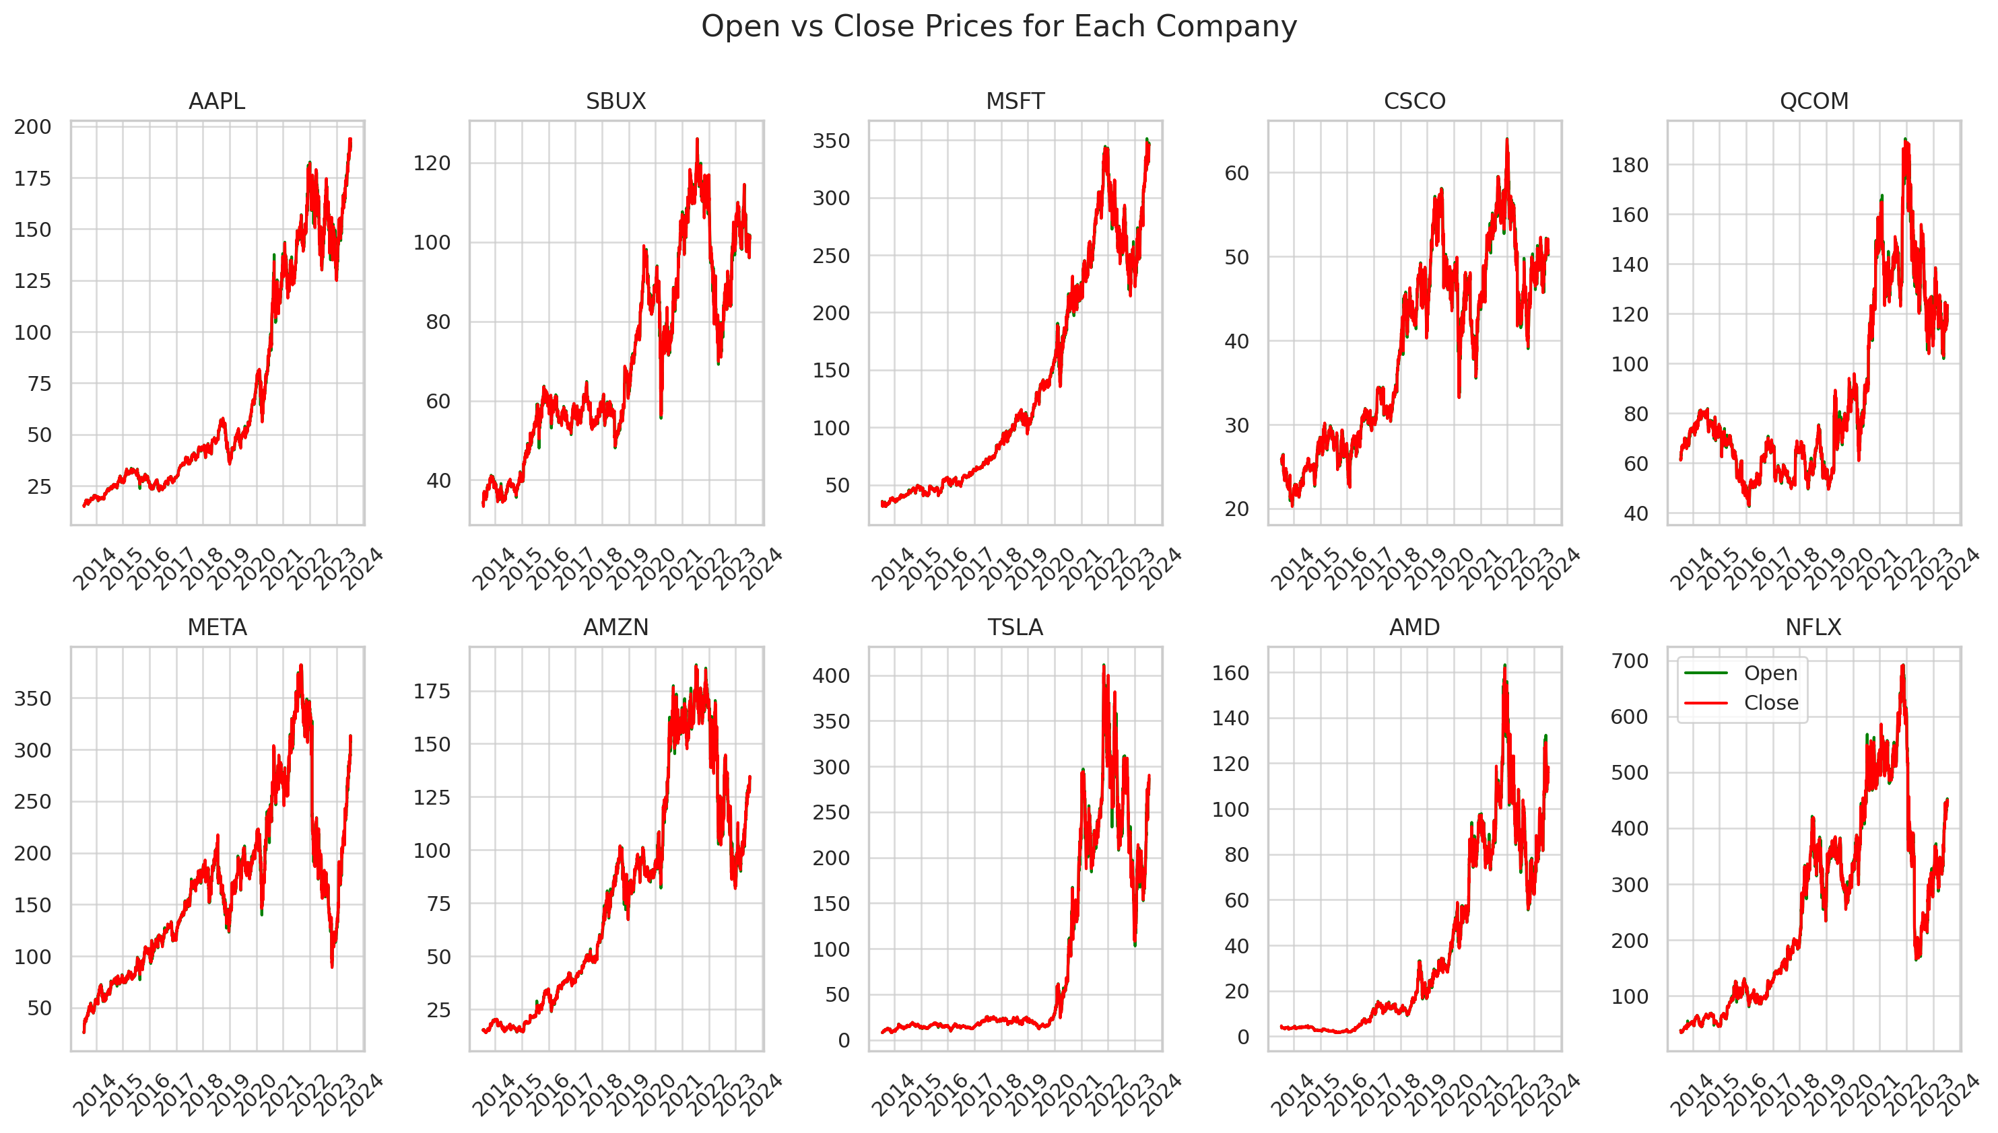

Slide 41
Thanks

